Slide 1

FPGA Contest 2020
Experimental Convolution Engine
Philippe THIRION
October 6th, 2020
Notes:
Choose from the existing cover option or create your own replacing the visual from the Photo library on Brand Connect

Slide 2
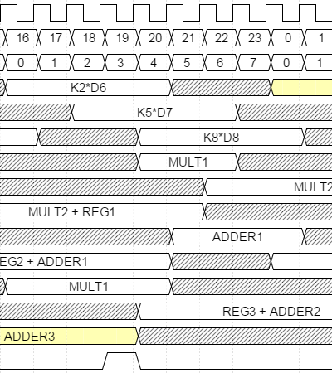
Agenda
Experimental Convolution ENGINE
Abstract
Idea
Concept
Realization
Status
Project outlook

Slide 3
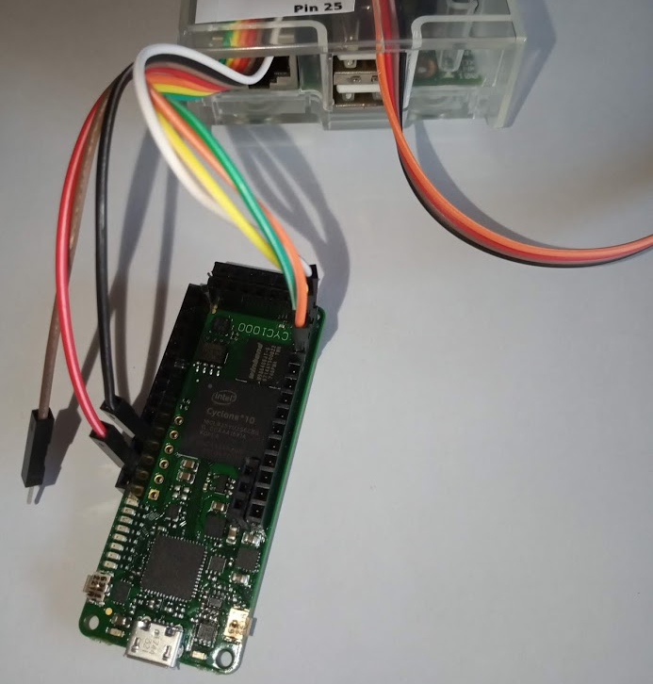
Arrow FPGA Contest 2020
Abstract
Design a 2D convolution engine with kernel 3x3.
Applications:
Image processing: contour/form detection
Deep learning : CNN layer
Function & features
Accelerator board
Operations use half precision floating point format (IEEE 754-2008) = float16
Use three computation units running concurrently
SPI interface to access logic
Configure image shape
Fill input memory & kernel matrix
Start/Monitor convolution calculation
Read output memory (result)

Slide 4
Arrow FPGA Contest 2020
IdEa
Matrix calculation is mostly performed using computers (and then CPUs).
But Tensorflow changes the game :
GPU or TPU can be used to accelerate matrix calculation.
And FPGAs have a role to play too !
Not only using processor or DSP IP core
Sequencer. Instructions.
But using dedicated custom blocks
Timing based.
Use concurrency (parallelism).
Pipeline techniques.
“Experimental Convolution Engine” project is for me an opportunity to explore this area …

Slide 5
Arrow FPGA Contest 2020
Concept
SPI interface (spimicro.vhd)
Internal memories
Convolution Engine (vcore.vhd)
Kernel RAM (dp16x16.vhd)
Timing + input control (kernel + input RAM) (controller.vhd)
Computation core
Kernel data shift (delay3.vhd)
Kernel data shift (delay3.vhd)
SPI commands decoding (micro.vhd)
Input RAM
(dp16384x16.vhd)
Computation Unit 1 (kernel.vhd)
Computation Unit 2 (kernel.vhd)
Computation Unit 3 (kernel.vhd)
Datapath (kernel9.vhd)
Datapath (kernel9.vhd)
Datapath (kernel9.vhd)
Output RAM
(dp16384x16.vhd)
Multipliers
(fp16mult.vhd x 2)
Multipliers
(fp16mult.vhd x 2)
Multipliers
(fp16mult.vhd x 2)
Output control (output.vhd)
SPI slave module (spislave.vhd)
Adders
(fp16adder.vhd x 3)
Adders
(fp16adder.vhd x 3)
Adders
(fp16adder.vhd x 3)
A SPI interface to access internal memories and for configuring and control purposes .
Use only internal memories (3x3 kernel, input image and output image).
Focus on the engine which perform the convolution.

Slide 6
Arrow FPGA Contest 2020
Realization
Highlights
The convolution engine is composed of three computation units running concurrently.
Use half precision floating point (float16) adders and multipliers.
Manage timing between memories accesses and the three computation units.
The trick: at one moment, all computation unit manages the same image pixels but with different kernel coefficients !
Use CYC1000 board:
Internal memory used is 89% (up to 128x128 pixels image size)
Tune clock frequency based on an internal PLL to find the higher frequency for the maximum efficiency using Timequest tool (=> 120 MHz)

Slide 7
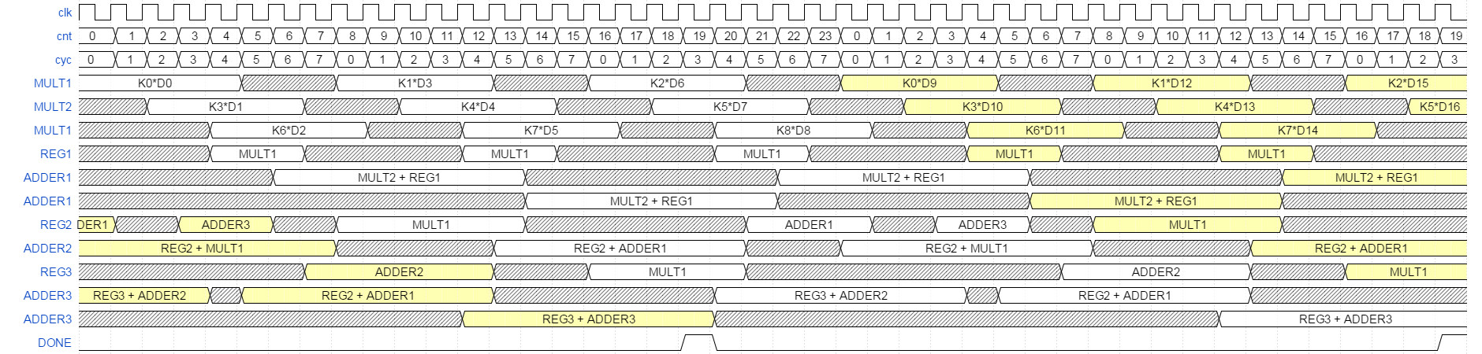
Arrow FPGA Contest 2020
Status
float16 adder operation lasts 7 clock cycles and float16 multiplier 5 clock cycles.
A kernel operation (9 multiplications + 8 additions) lasts 44 clock cycles using 2 multipliers and 3 adders … and a little of timing.
Kernel operations are nested.

Slide 8
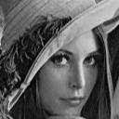


Arrow FPGA Contest 2020
TESTS
Use a Raspberry PI (3B) to drive the SPI interface of the FPGA.
128x128 pixels image processing lasts 1.1 ms (clock frequency = 120 MHz)
Compare with software convolution:
i5-3350P CPU @ 3.10GHz Quad Core : average is 762 μS (use scipy.signal.convolve2d)
… but a Raspberry PI (3B) is 60x slower !
Contour detection: Kernel [[ 0, -1, 0 ] [-1, 4, -1] [[ 0, -1, 0 ]] )
Input image (128x128)
Output image using FPGA
Output image using software on RPI

Slide 9

Arrow FPGA Contest 2020
Project outlook
Using SDRAM memory on board in order to process bigger images.
Using 2 banks of internal memories:
A bank accesses to SDRAM on board and
The other bank is used for computation.
Swap functions between banks.
Implementing more computation units to increase performance.
But internal RAM accesses will be less smart to manage.
Recently, I realized the possibility to reduce the float16 adder timing (from 7 to 5 clock cycles). This modification needs to review the computation unit timing. A shorter system timing should concevable.
Using float16 adder and multiplier pipeline version to avoid temporary register storage in computation unit (https://github.com/tirfil/vhdfp16/tree/master/VERSION2/VHDL).
Reusing float16 arithmetic modules to design other projects (like Fast Fourier Transform)
For Arrow FPGA Contest 2021 using an analogMAX board … perhaps

Slide 10
Arrow FPGA Contest 2020
EXTERNAL LINK
More details on:
https://github.com/tirfil/Experimental- Convolution-Engine
THANK YOU !

